Slide 1
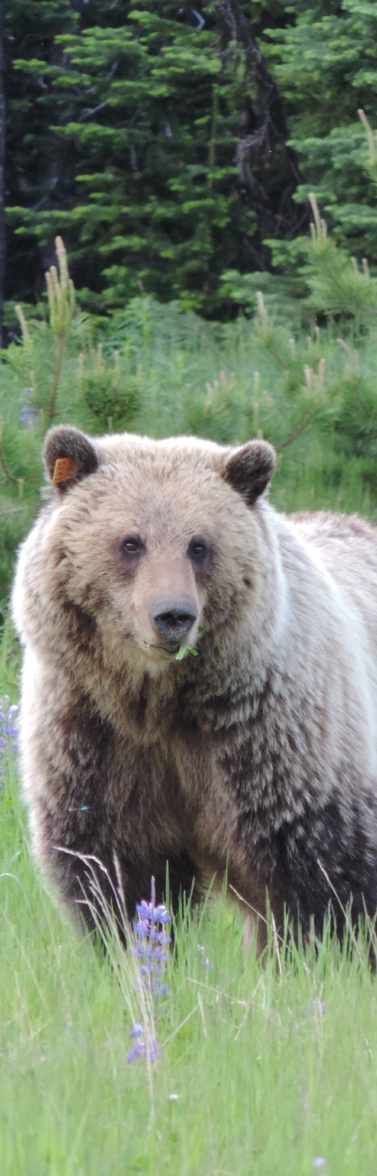

Grizzly-PAW: Grizzly Population Assessment in yelloWhead: Integrated Approaches Toward Conserving Grizzly Bears On A Human-Dominated Landscape Of Western Alberta.
Annual General Meeting – 1
Nicholas Coops
October 11th 2017

Slide 2
Thank You for Attending
Many thanks to all attendees for travelling long distances and taking time from their busy schedules
Special thanks to industrial sponsors for attending, both today and tomorrow
FRI Research (leadership, guidance and organization)
University faculty, graduate students and postdocs
Dr Frank van Manen (USGS)

Slide 3





Slide 4



Slide 5
Context for the Proposal
Conservation of Grizzly Bears in Western Alberta
Grizzly bears are considered a threatened species in Alberta
From a management perspective there is uncertainty about current population levels and how anthropogenic landscape change and human activities have affected grizzly bears in Alberta in the past and into the future.

Slide 6
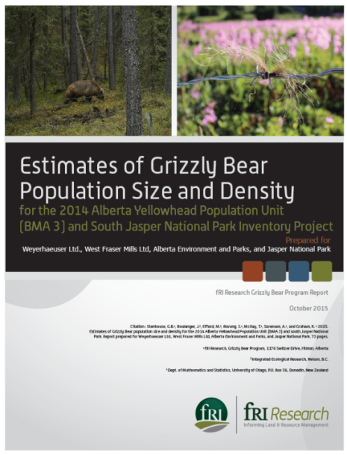
Within Yellowhead Bear Management Area, the first grizzly bear population unit inventory was in 2004 with the population estimated (based on DNA sampling) was 36 bears
A decadal survey was completed by FRI Research (Stenhouse) in 2014, with spurred this proposal.
The 2014 inventory estimated 71 using DNA in Yellowhead BMA indicating a 7% annual population rate increase
This is very encouraging given
the significant resource extraction
and human activity in the area

Slide 7
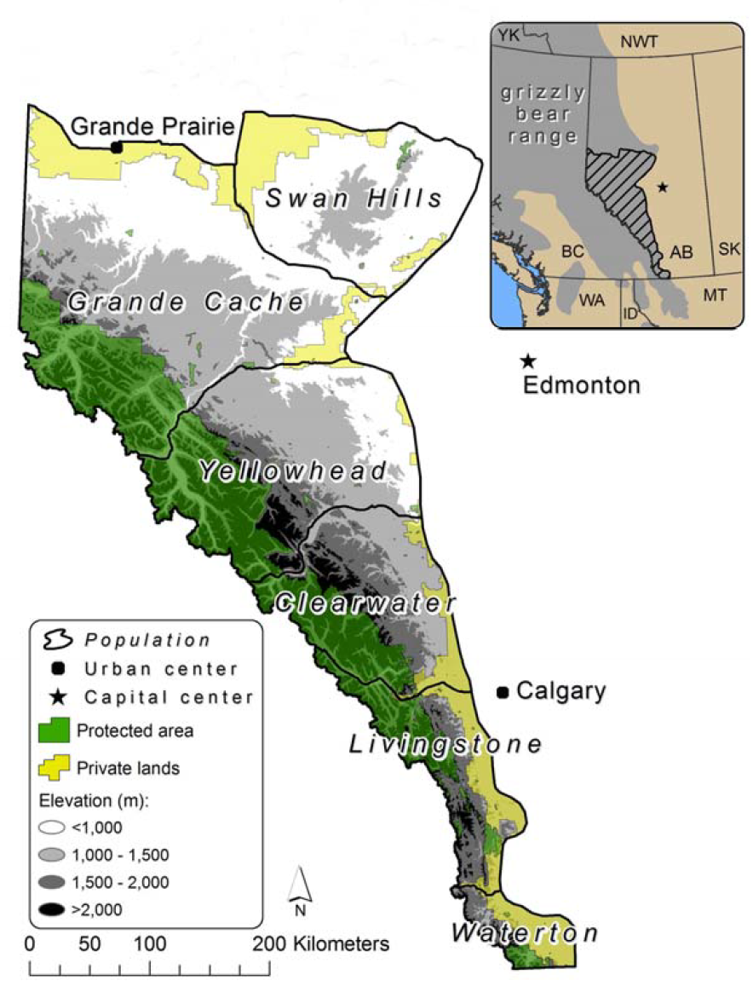
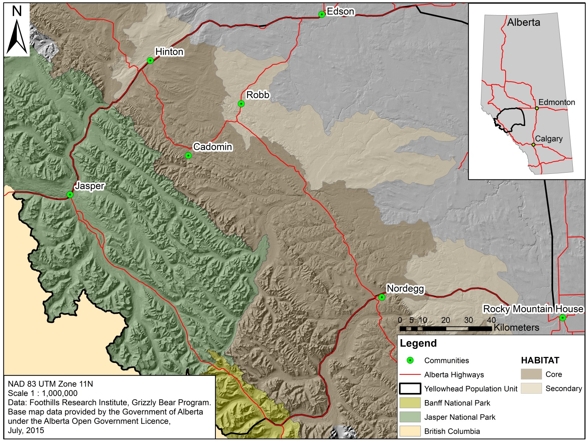

Slide 8
Report concludes that reasons behind the increases are unclear and additional research is needed.
How has (and could ) ongoing industrial and human activity impact habitat selection, health and mortality of grizzly bears in the region ?

Slide 9
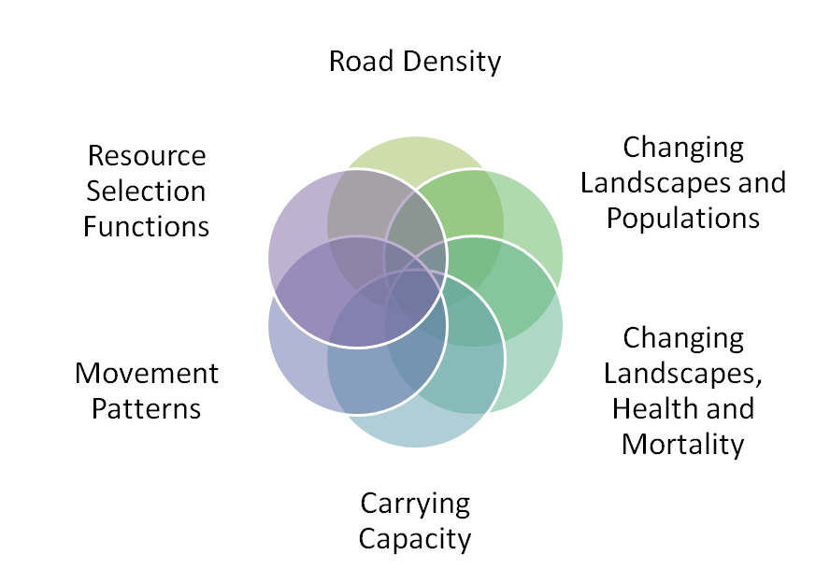
Industry Needs
8 key questions asked by Industry which this proposal aims to address

Slide 10
NSERC Collaborative and Development Project (CRD)
Three years
Approved for funding in July 2016
October 2016 all agreements in place
First year getting students and postdocs in place

Slide 11
In-kind Support
In addition to the generous financial report from each company NSERC doubles that contribution on the assumption that there is an equivalent in-kind.
This means 15 –25K in-kind support per year from each company (total $280K per year).
Thus far we have 18K

Slide 12
Your time is a major commitment.
Any time in meetings, AGM, phone calls, replying to emails and completing forms is in-kind
Any conversations / work with Gordon Stenhouse
Salary can be between $600 - $1000 per day
Vehicle usage is 0.70c / KM
Hotel /perdium is all eligible
For example for this AGM
  Drive Tuesday afternoon, All day Wed AGM, drive home Thursday AM
  2 hotel nights ($150 per night)
  100km in travel
  = $800 * 2 + 150* 2 + 100 * 0.7 = $1970 per person in-kind
NSERC expects the company to report the Inkind annually
See Curtis for more information when asked to report and he will guide you

Slide 13
Data
Existing data not collected for the project doesn’t not count
But data collected FOR the project, or data which you collected which has been modified to help the project counts
As you will see in the presentations… we would love access to:
  GIS road data
  Linear features mapping
  GPS tracks of vehicles
  Any traffic usage data you have
  Remote sensing data (LIDAR / aerial imagery)
  Forest Structure data (forest plots, vegetation survey data)
Data does NOT have to be just of the Yellowhead, can be for the larger Grizzly Bear regions

Slide 14
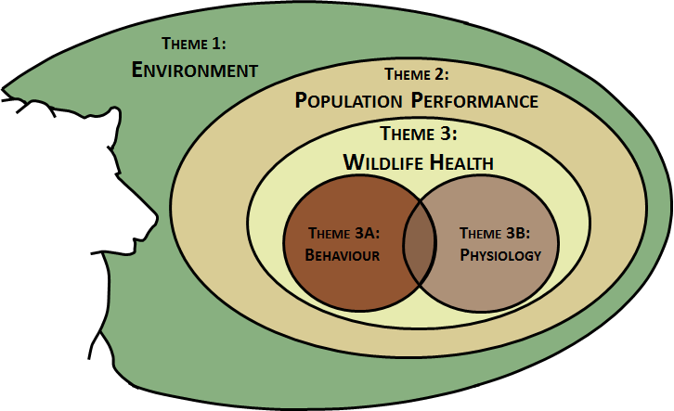

Slide 15
Three thematic areas of research and scales:
the environment that sets the broader landscape and environmental context of the Yellowhead bear management unit;
demographic responses relating to population status, size and change; and
wildlife health which involves individual-animal responses relating to their (a) behaviour and (b) physiology

Slide 16
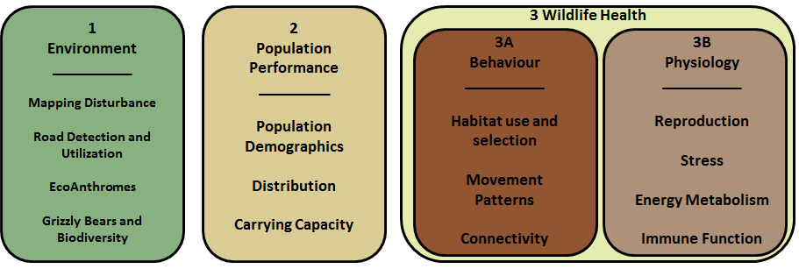

Slide 17
Today
AGM is planned as a series of presentations on the research to date under each theme
Update on the FRI Research Capture Program
Perspectives from industry (Keith Murray (AFPA)) and International colleague
Field day tomorrow to see the research underway first hand

Slide 18
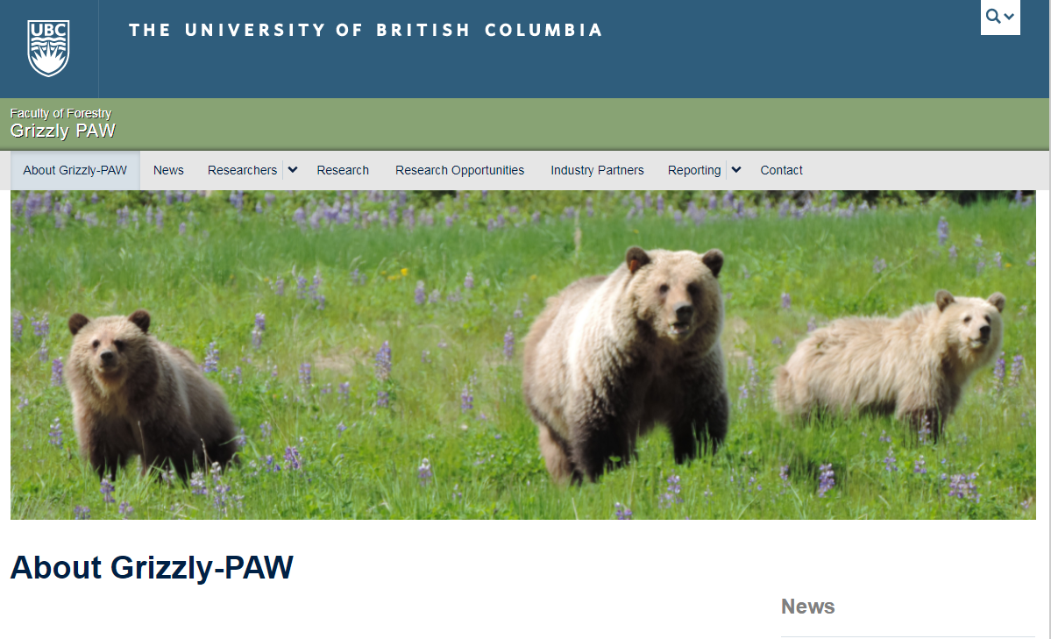
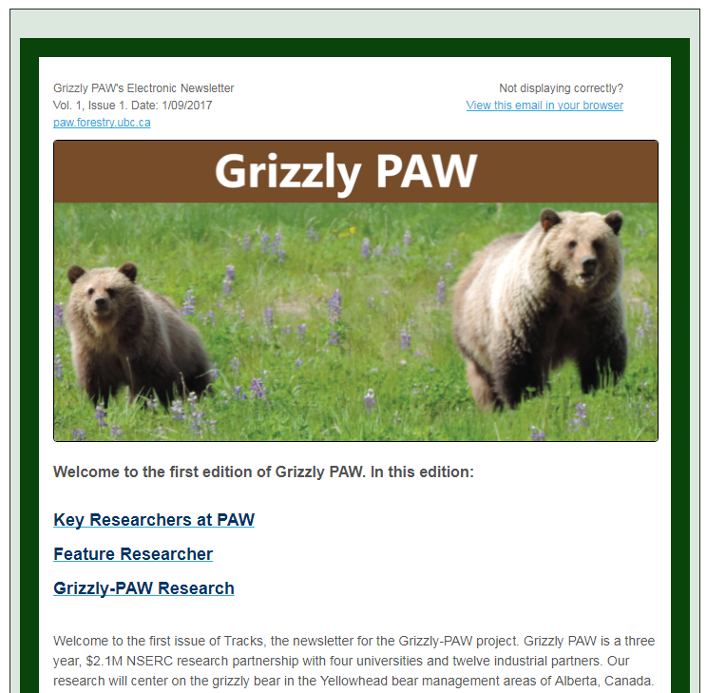
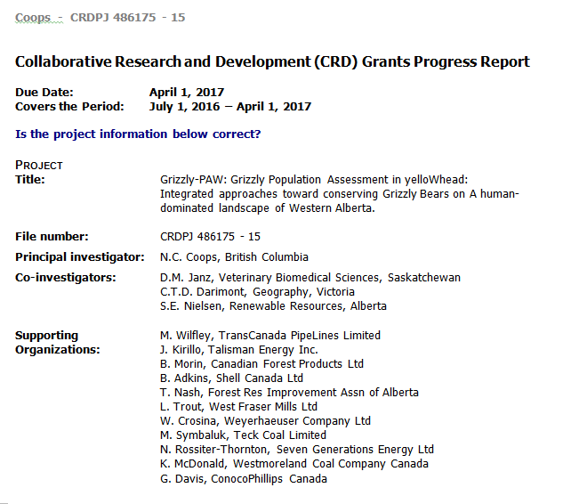
Ongoing Communication
Website:
Paw.forestry.ubc.ca
Pass: Grizzly!PawInfo
Newsletter
(Vol 1, 2 sent, 3 about to be)
NSERC reporting

Slide 19
Thankyou.
  Please interact with each other and the graduate students.
Curtis Marr (Project Manager)
  Curtis.marr@ubc.ca

Slide 22
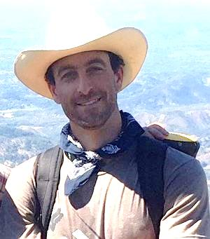

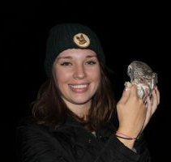
Theme 1
What are the temporal and spatial dynamics of fine-scale anthropogenic and non-anthropogenic disturbances and can they be characterized across the region?
What are the temporal and spatial dynamics of snow melt and spring flush and how do these interact to affect den emergence and spring habitat use and selection?
Do grizzly bears provide umbrella effects to other species, supporting their inclusion in a broader biodiversity management framework ?

Slide 24
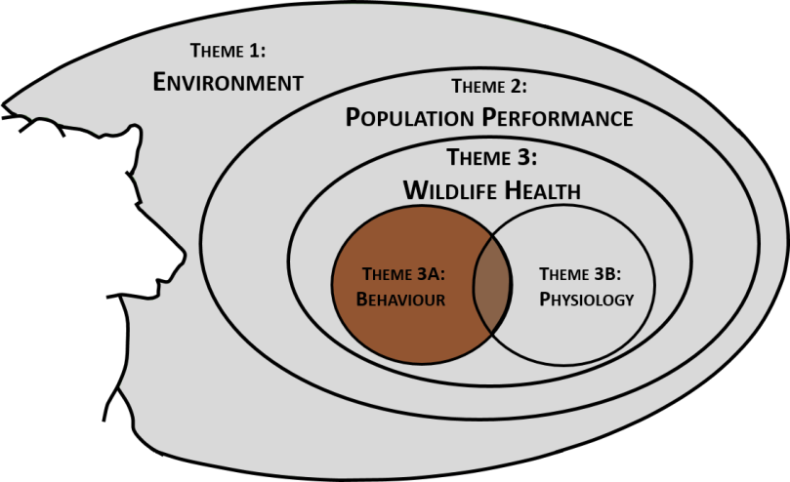
Theme 3A – Behavior and Movement
Finer scale analysis focused on individual bear movements
Can we characterize grizzly bear movement to better understand their response to future changes in the landscape ?
Is there a link between bear movement and changes in forest structure due to harvesting, fire and other resource extraction ?
What is the link between bear movements, landscape pattern and use, and mortality ?
How doe the timing of phenology impact bear food, savaging and mortality ?
What thresholds exist between bear movement and road processes ?
Industry Questions to be Addressed
Q4. Have changing landscape conditions resulted in changes in habitat selection by, and the health of, grizzly bears within the study area?
Q5. Are movement patterns of bears being impacted by natural resource extraction activities, including the development and use of roads and linear features?
Q7: Have changing landscape conditions affected grizzly bear mortality risk within the study area?

Slide 25

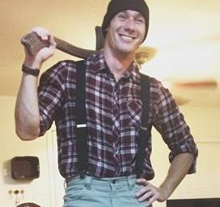
Theme 3A
Can grizzly bear responses to disturbance, as represented by movement and health, be modeled to allow probabilistic prediction of future movement associated with changes in landscape disturbance and habitat fragmentation?
Can grizzly bear movements be related to fine scale changes in forest structure, such as openings, gaps, and vegetation patterns?
Can changes in understory phenology, and forest structure at very fine spatial scales be linked to bear movement patterns?
  (MSc to be filled Y2)
What are the fine scale movement, health and survival responses to cumulative effects that are dynamic in space and time?
    (MSc to be filled Y2)
Have road density thresholds been effective, and are there improved approaches to understanding the links between road density and bear mortality across the Yellowhead ecosystem?
      (PDF to be filled Y2)

