Slide 1
Theme 1:
Environment
Theme 2:
Population Performance
Theme 3:
Wildlife Health
Theme 3A:
Behaviour
Theme 3B:
Physiology

Slide 2
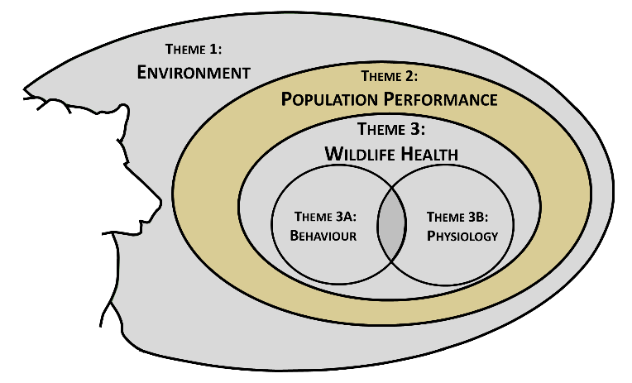
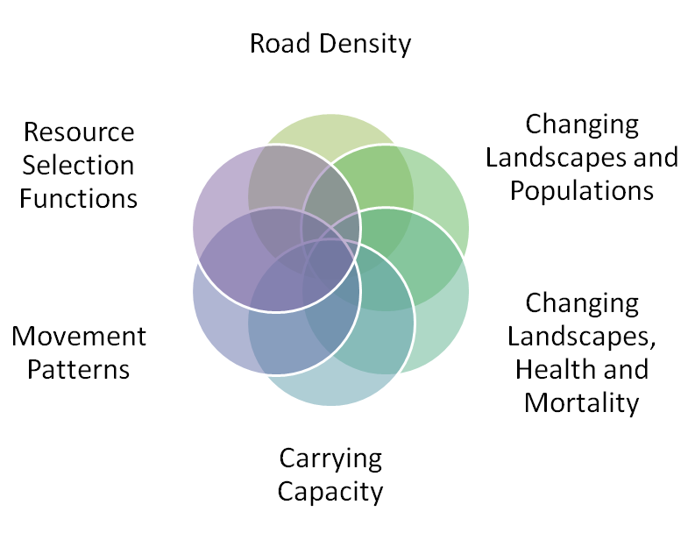
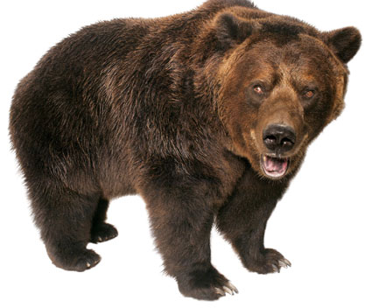
Theme 2 – Population performance (ecology)
Q1: Have road density thresholds influenced abundance & distribution (recovery) of bears?
Q2: Has landscape change (natural & anthropogenic) resulted in changes in population size/trends?
Q3: Can carrying capacity work be evaluated in terms of predicting densities & distribution of bears to inform land use/forest planning?
Q6: Do RSFs used by resource managers continue to provide useful surrogates for habitat quality in changing landscapes?
Bottom-up
Top-down
Roads, human activity,
landscape change,
& survival
Nutritional
Landscape
N & Density
but also
behaviour &
health

Slide 3
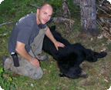
Theme 2: personnel & key topics
Sean Coogan (post-doctoral fellow):
What are the population trends (demographics) in the Yellowhead between 2004 & 2014 & can these changes be related to road density (top-down) & changes in landscape condition?
What are the nutritional constraints or trade-offs in our population & how does that relate to habitat change, behaviour, & health?
Chris Souliere (PhD student):
How does food supply change as a function of landscape change & how can this be incorporated into forest harvest planning?
How well do existing RSF functions compare to the landscape carrying capacity approach for the Yellowhead grizzly bear population?
Sean Coogan
(PDF)
Chris Souliere
(PhD student)

